Slide 1

ACTUATORS

Slide 2
CONTENTS
Permanent Magnet DC (PMDC) Motor
Stepper Motor
Brushless DC (BLDC) Motor

Slide 3
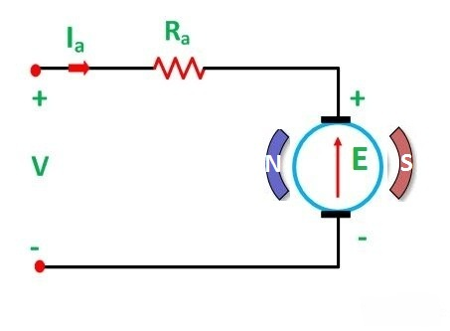
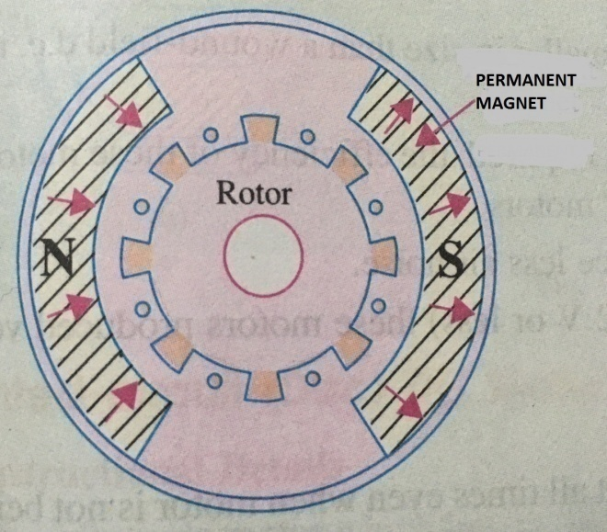
PERMANENT MAGNET DC (PMDC) MOTOR
A PMDC motor is a type of DC motor that uses a permanent magnet to create the magnetic field required for the operation of a DC motor.
PMDC motor consists of
Stator: It is a steel cylinder where the permanent magnets (Alnico magnets, rare earth magnets) are mounted in the inner periphery of this cylinder.

Slide 4
Continued….
Rotor (armature): It consists of core, windings and commutator. Armature core is made of number of slotted circular lamination of steel sheets. These slots on the outer periphery of the armature core are used for housing armature conductors in them.
The working principle of PMDC motor is just similar to the general working principle of DC motor i.e., when a current carrying conductor is placed inside a magnetic field, a mechanical force will be experienced by the conductor .
As in a permanent magnet DC motor, the armature is placed inside the magnetic field of permanent magnet; the armature rotates in the direction of the generated force.
Each conductor of the armature experiences a force and the compilation of those forces produces a torque, which tends to rotate the armature.

Slide 5
Continued..
Advantages:
Low cost
Higher efficiency
Smaller in size and portable
Disadvantages:
Permanent magnets cannot produce a high flux density as that as an externally supplied shunt field does.
There is a risk of demagnetization of the poles which may be caused by large armature currents.
Applications:
Toys
Windshield wipers

Slide 6

STEPPER MOTOR
Stepper motor is a brushless DC motor that rotates through a fixed angular step in response to each input current pulse received by its controller.
The angle through which the motor shaft rotates for each input current pulse is called the step angle β.
where N_{S} : number of stator poles
N_{r} : number of rotor poles
Smaller the step angle, greater the number of steps per revolution.

Slide 7
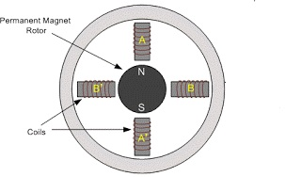
Stepper motor consists of
Rotor: Made of a permanent magnet (2 poles – N & S)
Stator: Made from stack of steel laminations with projecting poles (4 poles) each wound with a stator winding (A, B, A’, B’)
When a particular stator winding is energized, the rotor magnetic poles move into alignment with the excited stator poles.

Slide 8
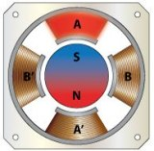
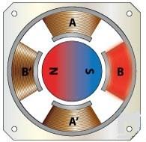
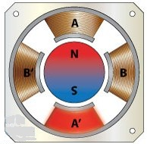
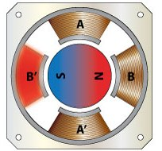
Step 1:
Stator winding A is energized , the rotor magnetic poles move into alignment with the excited stator pole. (θ = 0°)
Step 3:
Stator winding A’ is energized
Rotor rotates by a full step of another 90° in CW direction
Step 2:
Stator winding B is energized
Rotor rotates by a full step of 90° in clockwise (CW) direction
Step 4:
Stator winding B’ is energized
Rotor rotates by a full step of another 90° in CW direction

Slide 9
Continued..
Advantages:
Low cost
High reliability
A simple, rugged construction
Low maintenance
Disadvantages:
Require a dedicated control circuit
High torque output achieved at low speed
Applications:
Robotic arm
Paper feeder on printers
Tape drives, floppy disc drives

Slide 10
BRUSHLESS DC (BLDC) MOTOR
BLDC motor is a kind of permanent magnet synchronous motor.
Commutation of a BLDC motor is controlled electronically (no brushes, no commutator).
A BLDC motor consists of
Rotor : Incorporates the permanent magnets
Stator: Contains the coils. By applying DC power to the coil, the coil will energize and become an electromagnet.
The operation of BLDC motor is based on simple force of attraction between permanent magnet and an electromagnet.

Slide 11
Continued..
When coil A is energized, the opposite poles of rotor and stator are attracted to each other.
As the rotor nears coil A, coil B is energized and as the rotor nears coil B, coil C is energized.
As the rotor nears coil C, coil A is energized with opposite polarity.
This process is repeated and the rotor continues to rotate.

Slide 12
Continued..
BLDC motors often incorporate either internal or external position sensors to sense the actual rotor (Hall Effect sensor).
To rotate the BLDC motor, the stator windings should be energized in a sequence.
Rotor position is sensed using Hall effect sensors embedded into the stator.
Whenever the rotor magnetic poles pass near the Hall effect sensors, they give a high or low signal, indicating the N or S pole is passing near the sensors.
Based on the combination of these three Hall sensor signals, the exact sequence of commutation can be determined.

Slide 13
Continued..
Advantages of BLDC Motor
Better speed versus torque characteristics
High efficiency
Long operating life due to a lack of electrical and friction losses
Noiseless operation
Higher speed ranges
Disadvantages of BLDC Motor
These motors are costly
Electronic controller required control this motor is expensive
Not much availability of many integrated electronic control solutions, especially for tiny BLDC motors
Requires complex drive circuitry
Need of additional sensors

Slide 14
Continued..
Applications of BLDC Motors
Computer hard drives and DVD/CD players
Electric vehicles, hybrid vehicles, and electric bicycles
Industrial robots, CNC machine tools, and simple belt driven systems
Washing machines, compressors and dryers
Fans, pumps and blowers
DEPARTMENT OF E&E ENGINEERING

